Slide 1
Presentation brief for MCT’s
Title of presentation | Real-time Stream Processing with Stream Analytics
Presentation\Lab length | Presentation: 10 - 20 minutes Lab: 50 – 60 minutes
Audience | Data Engineers, Data Scientists, Data Professionals, Data Architects, BI Professionals, Developers
Purpose | Enable reliable messaging for Big Data applications using Azure Event Hubs Work with data streams by using Azure Stream Analytics Transform data by using Azure Stream Analytics
(think) Student key takeaways | The student should understand real-time messaging for big data applications using Azure Event Hubs The student should know how to work with data streams by using Azure Stream Analytics The student should comprehend data transformation techniques by using Azure Stream Analytics
(feel) Student desired mindset | The student may feel confusion to understand the differences between Azure Event Hubs and Azure Stream Analytics. The student may not be familiar with real-time messaging for big data applications The student may feel confusion with windowing functions techniques using Azure Stream Analytics.
(do) Student outcomes | The student should be able to articulate a one sentence description of real-time data streaming architecture The student should be able to comprehend Azure Stream Analytics and Event Hubs The student should be able to work with and transform incoming data-streams using Azure Stream Analytics
More information | For MCT course feedback, visit the Microsoft Official Courseware forum
Notes:
Instructor notes and guidance
This slide is for MCT use only, outlining the aims and objectives of this module.

Slide 2
DP-203T00: Real-time Stream Processing with Stream Analytics
Notes:
Instructor notes and guidance
Introduce to the students that this module explores real-time stream processing using Azure Stream Analytics. At this stage, the students are being introduced to the technologies of Azure Stream Analytics, Azure Synapse Analytics and Event Hubs.
They will focus on the configurations of Azure Stream Analytics and Azure Event Hubs with Azure Synapse Analytics, as well as scripts to use for transformations using Azure Stream Analytics. They will also explore the setup for ingestion messages using Azure Event Hubs.
In the lab, we take the opportunity to let the students learn how to process streaming data with Azure Stream Analytics. They will ingest vehicle telemetry data into Event Hubs, then process that data in real time, using various windowing functions in Azure Stream Analytics. They will output the data to Azure Synapse Analytics. Finally, they will learn how to scale the Stream Analytics job to increase throughput.

Slide 3

Agenda
Lesson 01 – Enable reliable messaging for Big Data applications using Azure Event Hubs
Lesson 02 – Work with data streams by using Azure Stream Analytics
Lesson 03 – Transform data by using Azure Stream Analytics
Notes:
Instructor notes and guidance
This space has been left deliberately blank.

Slide 4
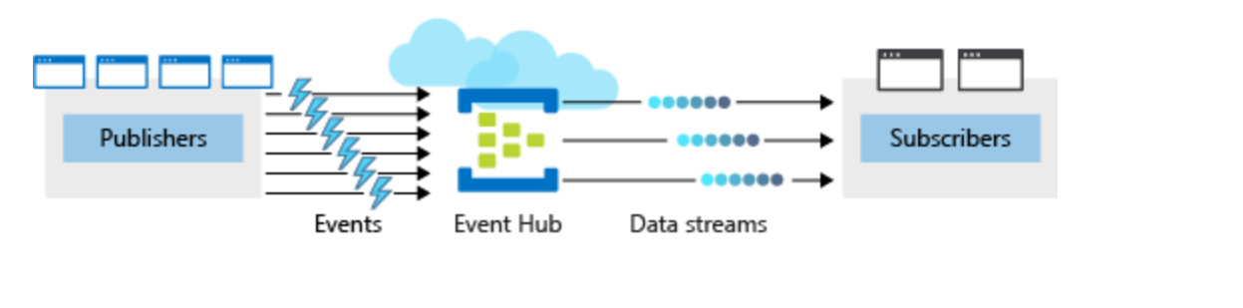
Enable reliable messaging for Big Data applications using Azure Event Hubs
Notes:
Talking points
The following artefacts of the architecture for reliable messaging for big data applications using Azure Event hubs are discussed:
Azure Event Hub:
An Azure Event Hub acts as a front door for an event pipeline, to receive incoming data and stores this data until processing resources are available.
Publishers in Azure Event Hubs:
A publisher is an entity that sends data to the Event Hubs. Event publishers are any app or device that can send out events using either HTTPS or Advanced Message Queuing Protocol (AMQP) 1.0.
Events:
An event is a small packet of information (a datagram) that contains a notification. A single event (individual or batch event) can’t exceed 1mb
Data Streams
The stream of incoming data that needs to go to the subscribers
Subscribers:
Subscribers are an entity in a messaging applications within Azure Event Hubs that reads data from the Event Hubs.
Instructor notes and guidance
Tell the students that coverage of Azure Stream Analytics, and data transformation techniques within Azure Stream Analytics is provided in the following slides.
This slide focusses on the first stage of stream processing where data is ingested using Azure Event Hubs. You may get students asking about IOT hubs. Call out that these work in a similar way to Event Hubs and are covered in depth in the IOT Developer course
Call out to the students, that in the lab for this module, they will be taught how to process streaming data with Azure Stream Analytics. They will ingest vehicle telemetry data into Event Hubs, then process that data in real time, using various windowing functions in Azure Stream Analytics. They will output the data to Azure Synapse Analytics. Finally, they will learn how to scale the Stream Analytics job to increase throughput. This in order to establish an end-to-end streaming solution.
Recommended reading for this slide
Create an Event Hub using the Azure CLI - Learn | Microsoft Docs

Slide 5
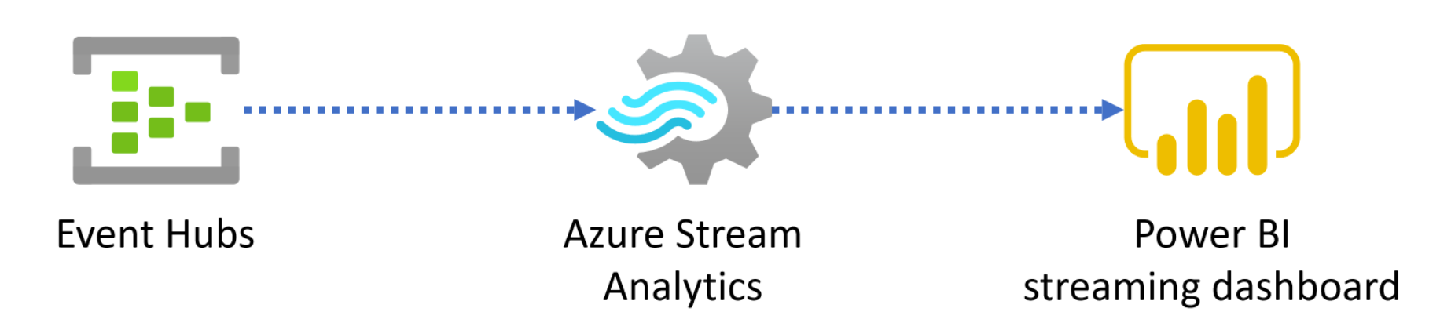
Work with data streams by using Azure Stream Analytics
Notes:
Talking points
Data streams is data pertaining to the occurrence of specific activities that are emitted by applications, IoT devices or sensors, or other sources known as data producers. These perpetually generated data streams and typically contain temporal and additional information about the events. Analyzing a data stream is performed to measure how an event's state changes over time or to capture information on an area of interest.
There are two approaches to processing data streams: live and on-demand.
The following artefacts of the architecture for working with data streams using Azure Stream Analytics is an example of a live approach to process data streams.
It is one of the most commonly adopted methods for processing data streams. It enables you to analyze incoming data continuously.
In the architecture the new data arrives from an event producer, in this case Azure Event Hubs.
The live approach does require more processing power versus the on-demand approach, but you will gain the ability to get near-real-time insights that can be showcased in a Power BI streaming dashboard.
In the architecture Azure Stream Analytics is the service where you execute calculations and aggregations from the data that arrived from the Azure Event Hub. This enables you to perform temporal analysis.
The results of the queries written in Azure Stream Analytics can then be sent to a Power BI dashboard for visualizations in real-time.
Instructor notes and guidance
This slide provides the architecture of a live streaming process. In the previous slide, we have gone in-depth about how data arrives in Azure Event Hubs.
Within Azure Stream analytics, the students can write queries, to temporarily transform data before visualizing it in a power bi dashboard.
Please enforce to students that within Azure Stream Analytics, they can execute calculations and aggregations from data that has arrived from Azure Event hubs.
In the lab, students will use queries in Azure Stream Analytics to temporarily transform the data, such that it can be consumed and visualized in a power bi dashboard.
Recommended reading for this slide
Understand data streams - Learn | Microsoft Docs

Slide 6
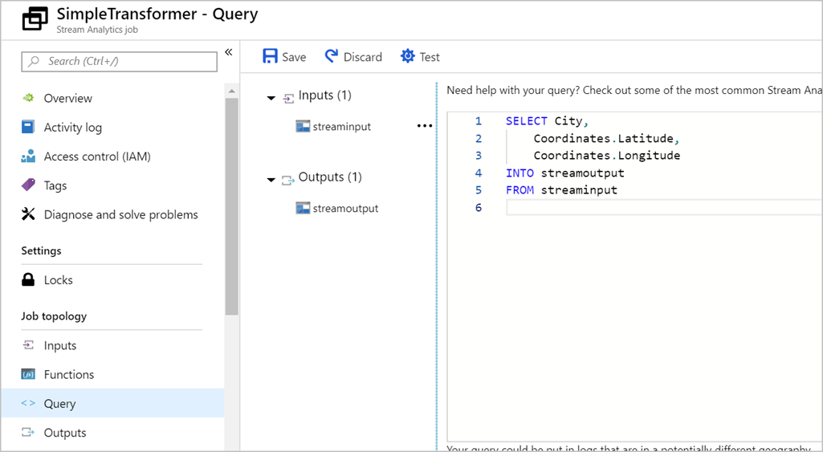
Transform data by using Azure Stream Analytics
Declarative SQL like language
Contains testing capabilities
Performs aggregations over windows of time
Notes:
Talking points
Azure Stream Analytics enables you to develop massively parallel Complex Event Processing (CEP) pipelines with simplicity. In these pipelines you are enabled to author powerful, real-time analytics solutions using very simple, declarative SQL like language with embedded support for temporal logic. You can, for example, perform aggregations on the telemetry data over certain windows of time. With the test feature within Azure Stream Analytics, you can easily test the query if the output is what you expected.
In Azure Stream Analytics, we call this pipeline a job, which is a unit of execution.
A Stream Analytics job pipeline consists of three parts:
- An input that provides the source of the data stream.
- A transformation query that acts on the input. For example, a transformation query could aggregate the data over windows of time
- An output that identifies the destination of the transformed data.
Instructor notes and guidance
This slide will showcase the features to query and transform data, but only at a product level of Azure Stream Analytics.
In the lab, the student will perform window aggregations by using the declarative SQL language, and see how these transform the data by visualizing it in in Power BI.
Recommended reading for this slide
Transform data by using Azure Stream Analytics - Learn | Microsoft Docs

Slide 7
Review questions
Q01 – Which technology typically provide an ingestion point for data streaming in an event processing solution that uses static data as a source?
A01 – Azure Blob storage
Q02 – Which three parts consist of an Azure Stream Analytics job pipeline
A02 – An input, a transformation query, and an output
Q03 – What query language does Azure Stream Analytics use?
A03 – SAQL
Notes:
Instructor notes and guidance
This space has been left deliberately blank

Slide 8
Lab: Real-time Stream Processing with Stream Analytics
Notes:
Instructor notes and guidance
This space has been left deliberately blank

Slide 9
Lab overview
This lab teaches you how to process streaming data with Azure Stream Analytics. You will ingest vehicle telemetry data into Event Hubs, then process that data in real time, using various windowing functions in Azure Stream Analytics. You will output the data to Azure Synapse Analytics. Finally, you will learn how to scale the Stream Analytics job to increase throughput.
Lab objectives
After completing this lab, you will be able to:
Use Stream Analytics to process real-time data from Event Hubs
Use Stream Analytics windowing functions to build aggregates and output to Synapse Analytics
Scale the Azure Stream Analytics job to increase throughput through partitioning
Repartition the stream input to optimize parallelization
Notes:
Instructor notes and guidance
In the lab, we take to opportunity to explore how to process streaming data with Azure Stream Analytics. The student will ingest vehicle telemetry data into Event Hubs, then process that data in real time, using various windowing functions in Azure Stream Analytics. The data will be outputted to Azure Synapse Analytics. Finally, the student will learn how to scale the Stream Analytics job to increase throughput.
In exercise 1, here the students will be configuring the services, they will configure Event Hubs, Azure Synapse Analytics and Azure Stream Analytics.
In exercise 2, the students will focus on visualizing the streaming data, students will run the data generator in order to receive data, will create the Power BI dashboard that will showcase the generated data, and will view the aggregated data in Azure Synapse Analytics.

Slide 10













Lab 14 Overview
asacosmosdb<unique_suffix>
CosmosDB
Campaign Info
Azure Databricks
asagadatalake<unique_suffix>
Eventhub<suffix>
Cluster
Azure Data Lake
wwi-02
Event Hub
Vehicle data
Products (parquet)
dp203sql<unique_suffix>
asa<suffix>
Stream Analytics
Aggregated and anomaly
Vehicle data
SourceDB
Azure Synapse Analytics
Dedicated SQL Pool (SQLPool1)
Built-In Serverless SQL Pool
Apache Spark pool
Pipelines and Dataflows
Power BI
asagaworkspace<unique_suffix>
Notes:
This slide is an optional slide that you can use to show a high level overview of the technologies used in the lab.
This lab teaches you how to process streaming data with Azure Stream Analytics. You will ingest vehicle telemetry data into Event Hubs, then process that data in real time, using various windowing functions in Azure Stream Analytics. You will output the data to Azure Synapse Analytics. Finally, you will learn how to scale the Stream Analytics job to increase throughput.

Slide 11
Lab review
Q01 – How can you extend Azure Stream Analytics with custom code?
Q02 – What is Azure Event Hubs?
Q03 – What does the following command do: GROUP BY TumblingWindow(Duration(second, 2))
Notes:
Answers
Question 1 - Using JavaScript User Defined Functions
Question 2 - Azure Event Hubs is a big data pipeline that can ingest millions of events per second.
Question 3 - The query groups a variable over a two second duration using the Tumbling Window function

Slide 12
Module summary
In this module, you have learned about:
Azure Stream Analytics
Azure Event Hubs
Windowing Functions
Partitioning
Azure Synapse Analytics
Next steps
After the course, consider visiting the website that explores a [Azure Stream Analytics solution patterns] Azure Stream Analytics solution pattern and the associated documentation that goes into more depth about this architecture.
Notes:
Instructor notes and guidance
The next steps is suggested post course learning materials to reinforce what they have learned in the module.

Slide 13
Closing slide
Notes:
Instructor notes and guidance
This space has been left deliberately blank

